Slide 1
Chap 1: Intro. to AI
FSKKP, UMP
BCS2313: Artificial Intelligence Techniques

Slide 2
What You’ll Learn
Introduction to AI
What is AI?
AI History
Foundation of AI
The AI Problem
AI Applications

Slide 3
Two Big Questions of the Universe
For over two thousand years, philosophers have been trying to resolve two big question:
How human mind works?
Can non-human have mind?
However, this question are still unanswered..
Some accepted that it can be done, and
Others opposed this ideas, claimed that love, creative discovery, emotion, moral choice will be always beyond reach of any machine.

Slide 4
Two Big Questions of the Universe
Is it true??
love, creative discovery, emotion, moral choice will be always beyond reach of any machine...

Slide 5
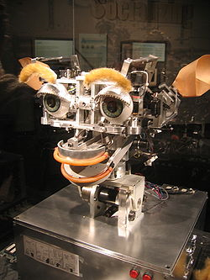
KISMET
Made by Dr. Cynthia Breazeal for her Ph.D thesis at Massachusetts Institute of Technology (MIT).
Demonstrate social interaction, human emotion.
Simulates emotion through various facial expressions, vocalizations, and movement.

Slide 6
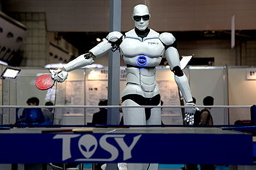
TOPIO
TOPIO ("TOSY Ping Pong Playing Robot")
Humanoid robot designed to play table tennis against a human being.
Developed since 2005, in Vietnam
uses an advanced artificial intelligence system to learn and continuously improve its skill level while playing

Slide 7
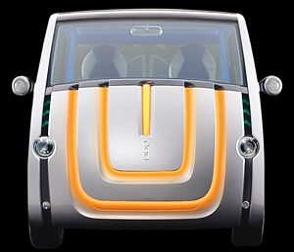
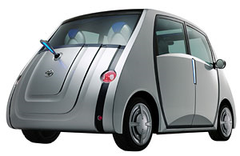
Toyota POD
“Emotion” car
Play your favorite music
Reflect your mood through a display of different coloured lights on the front.
Pod could express its own feelings with coloured LEDs - red for anger, yellow for happy, blue for sad
Wag its antenna 'tail' when its happy.

Slide 8
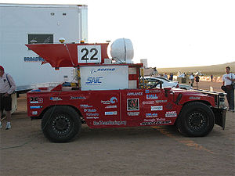
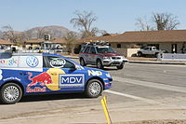
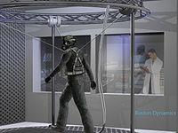
DARPA Grand Challenge
Autonomous cars and robots challenge in the USA
Funded by the Defense Advanced Research Projects Agency, United States Department of Defense.
The challenge:-
2004 Grand Challenge – USD1mill. (no winner)
2005 Grand Challenge – USD2mill. (Stanford Univ.)
2007 Urban Challenge – USD2mill. (Carnegie Mellon Univ.)
2012 Robotics Challenge – ongoing.

Slide 9
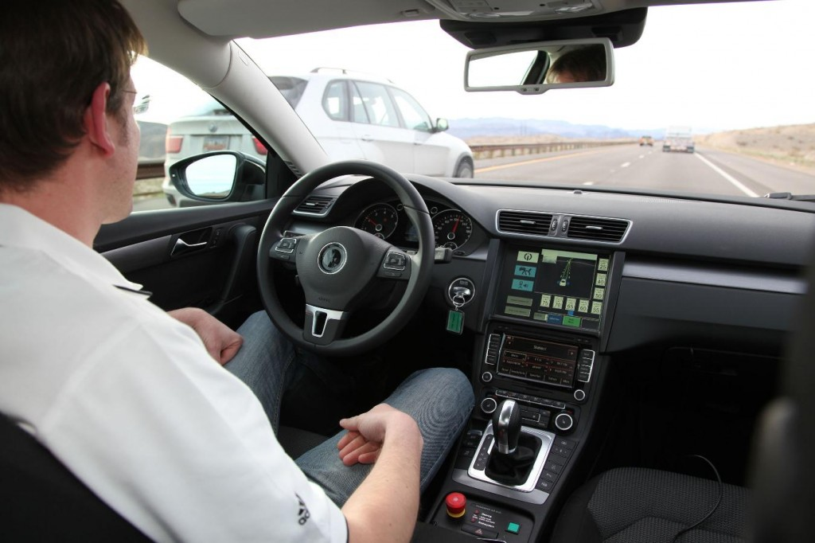
Autonomous Car
Automated vehicle, robotic car or self-driving car.
Capable to navigate entirely without any human input.
United States is the first country to allow autonomous car to driven in their road (Nevada, Florida & California).
.
Used state-of-the art technologies such as radar, lidar, GPS and computer vision to sense the surroundings and navigate the car.

Slide 10
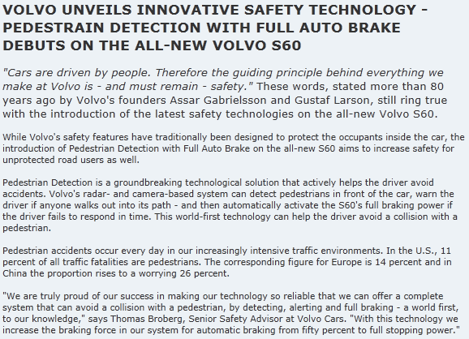
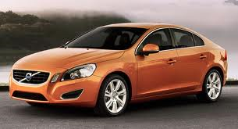
Volvo: Pedestrian Detection

Slide 11





Slide 12
Meaning of Intelligence

Slide 13
The Meaning of “Intelligence”
Someone’s intelligence is their ability to understand and learning things.
Intelligence in the ability to think and understand instead of doing things by instinct or automatically
(Essential English Dictionary, Collins London 1990)

Slide 14
The Meaning of “Intelligence”
Intelligence has been defined in different ways, including the abilities for abstract thought, understanding, communication, reasoning, learning, planning, emotional intelligence and problem solving. Intelligence is most widely studied in humans, but has also been observed in animals and plants.
(www.wikipedia.org)

Slide 15
The Meaning of “Intelligence”
Intelligence is the computational part of the ability to achieve goals in the world. Varying kinds and degrees of intelligence occur in people, many animals and some machines.
(John McCarthy, Stanford University)

Slide 16
Meaning of AI

Slide 17
AI Definition
Ai is a study of intelligent behavior (in human or animal) and attempt to find ways to put it in a machine or computer.
(from our first AI class; Class Introduction)

Slide 18
AI Definition
It is the science and engineering of making intelligent machines, especially intelligent computer programs. It is related to the similar task of using computers to understand human intelligence, but AI does not have to confine itself to methods that are biologically observable.
(John McCarthy, Stanford University)

Slide 19
AI Definition
Research scientists in Artificial Intelligence try to get machines to exhibit behavior that we call intelligent behavior when we observe it in human beings.
(James R Slagle; Artificial Intelligence: The Heuristic Programming Approach, McGraw-Hill)

Slide 20
AI Definition
The goal of work in artificial intelligence is to build machines that perform tasks normally requiring human intelligence.
(Nils Nilsson; Problem-Solving Methods in Artificial Intelligence, McGraw-Hill)

Slide 21
AI Definition
Artificial intelligence is the intelligence of machines and the branch of computer science that aims to create it
(www.wikipedia.org)

Slide 22
Some AI Definition
The branch of computer science concerned with making computers behave like humans. The term was coined in 1956 by John McCarthy at the Massachusetts Institute of Technology (MIT)
(www.webopedia.com)

Slide 23
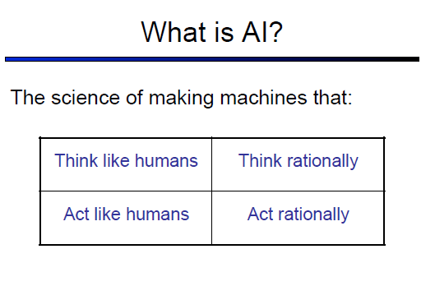

Slide 24
Rational Decisions
We’ll use the term rational in a particular way:
Rational: maximally achieving pre-defined goals
Rational only concerns what decisions are made
(not the thought process behind them)
Goals are expressed in terms of the utility of outcomes
Being rational means maximizing your expected utility

Slide 25
Rational System
A rational system is one whose agent function always acts to maximize its performance measure, given its percept sequence until the current moment.

Slide 26
AI Definition
What you say ?

Slide 27
Brief History of AI
The beginning of AI (1943 - 1956):
1943: McCulloch & Pitts: Boolean circuit model of brain.
1950: Turing’s “Computing Machinery and Intelligence”.
1956: John McCarthy coined the term "artificial intelligence" as the topic of the Dartmouth Conference, the first conference devoted to the subject.
Rise of AI, era of great expectations (1956 - 1960):
Early successful AI programs: Samuel’s checkers,
Newell & Simon’s Logic Theorist, Gelernter’s Geometry
Theorem Prover.
Robinson’s complete algorithm for logical reasoning.

Slide 28
Brief History of AI
A dose of reality (1966 - 1974):
AI discovered computational complexity.
Neural network research almost disappeared after
Minsky & Papert’s book in 1969.
Knowledge-based systems (1969 - 1979):
1969: DENDRAL by Buchanan et al..
1976: MYCIN by Shortliffle.
1979: PROSPECTOR by Duda et al..

Slide 29
Brief History of AI
AI becomes an industry (1980 - 1988):
Expert systems industry booms.
1981: Japan’s 10-year Fifth Generation project.
The return of NNs and novel AI (1986 - present):
Mid 80’s: Back-propagation learning algorithm reinvented.
Expert systems industry busts.
1988: Resurgence of probability.
1988: Novel AI (ALife, GAs, Soft Computing, …).
1995: Agents everywhere.
2003: Human-level AI back on the agenda.

Slide 30
Brief History of AI
AI becomes an industry (1980 - 1988):
Expert systems industry booms.
1981: Japan’s 10-year Fifth Generation project.
The return of NNs and novel AI (1986 - present):
Mid 80’s: Back-propagation learning algorithm reinvented.
Expert systems industry busts.
1988: Resurgence of probability.
1988: Novel AI (ALife, GAs, Soft Computing, …).
1995: Agents everywhere.
2003: Human-level AI back on the agenda.

Slide 31
Brief History of AI
AI becomes an industry (1980 - 1988):
Expert systems industry booms.
1981: Japan’s 10-year Fifth Generation project.
The return of NNs and novel AI (1986 - present):
Mid 80’s: Back-propagation learning algorithm reinvented.
Expert systems industry busts.
1988: Resurgence of probability.
1988: Novel AI (ALife, GAs, Soft Computing, …).
1995: Agents everywhere.
2003: Human-level AI back on the agenda.

Slide 32
Turing Test
(Developed by Alan Turing, a British Mathematician)
Attempts to determine whether the responses from a computer with intelligent behavior are indistinguishable from responses from a human

Slide 33
Turing Test
Imitation Game
Human
Human Interrogator
AI System

Slide 34
Why AI?
Computer have outperform human in many tasks:-
Numerical computations
More faster and accurate than human
Give result almost instantaneously, where human take time to solve same calculation
Human: chances of errors are more
E.g; 128798 x 986435 =? or 876837863 ÷ 789 = ?

Slide 35
Why AI?
Computer have outperform human in many tasks:-
Information storage
Computer can store very huge amounts of information and the information are intact and precise
Human can only store certain amount of information and the information can be faulty or degraded over time
Hard disk vs. Human brain!

Slide 36
Why AI?
Computer have outperform human in many tasks:-
Repetitive operation
Human beings get bored and commit mistakes, as fatigue while performing repetitive tasks
Computer are meant to do such tasks, and will not get bored, complain while doing the same task over and over again

Slide 37
Why AI?
Numerical computation, information storage and repetitive task are “mechanical” and “mindless” – good for computers
“Intelligent” tasks, humans are better than computers

Slide 38
Why AI?
Intelligence of one person may vary to another person, but we share almost all characteristics of intelligence:-
Respond to situations very flexible
Make sense of ambiguous or erroneous situation
Find similarities even though the situations might be different
Draw distinction between situation even though there are many similarities between it

Slide 39
Why AI?
Task that demand intelligence for the computers
Speech recognition and understanding
Pattern recognition
Reasoning
Motion in a dynamic obstacle filled space
Decision making

Slide 40
AI Techniques/Approach/
Neural network
Case-based reasoning
Affective computing
Data mining
Expert system
Natural language processing
Machine vision
…. and many more

Slide 41
Branch of AI
Search
pattern recognition
Representation
Inference
common sense knowledge and reasoning
learning from experience
Planning
Epistemology - This is a study of the kinds of knowledge that are required for solving problems in the world.
Ontology - Ontology is the study of the kinds of things that exist.
heuristics

Slide 42
Conclusion
AI has a dual role: 1) to study human intelligence and 2) to study machine intelligence.
AI will assimilate in every field.

Slide 43
Next Class, What You’ll Learn
CO Cover: CO1 – Point out the artificial intelligence concept in computer science.
AI Topic: Chap 2 – Case-Based Reasoning

Slide 44
Q & A

Slide 45
Computational Sustainablity
Computational sustainability is a new interdisciplinary field that aims to apply techniques from computer and information science and related disciplines (for example, operations research, applied mathematics, and statistics) to the balancing of environmental, economic, and societal needs, in order to support sustainable development and a sustainable future.

Slide 46
Green Computing
Green computing is the study and practice of designing, manufacturing, developing - efficiently and effectively with minimal or no impact on the environment .

Slide 47
How can artificial intelligence support sustainable development and a sustainable future. Give your opinion and thought about this issues.

